Slide 1
Distributed Systems
Ali Kamandi, PH.D.
School of Engineering Science
College of Engineering
University of Tehran
kamandi@ut.ac.ir

Slide 2
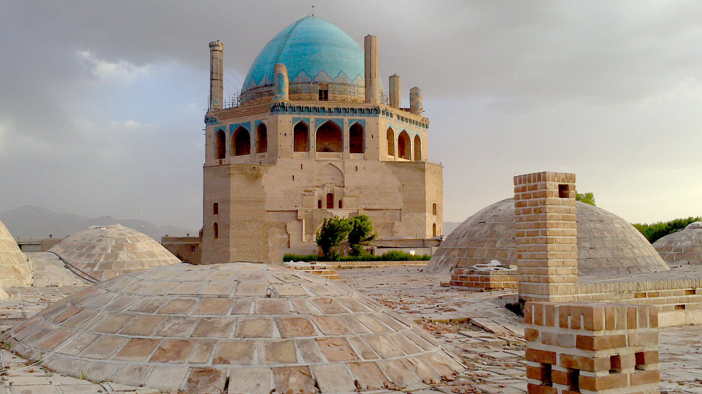

Slide 3
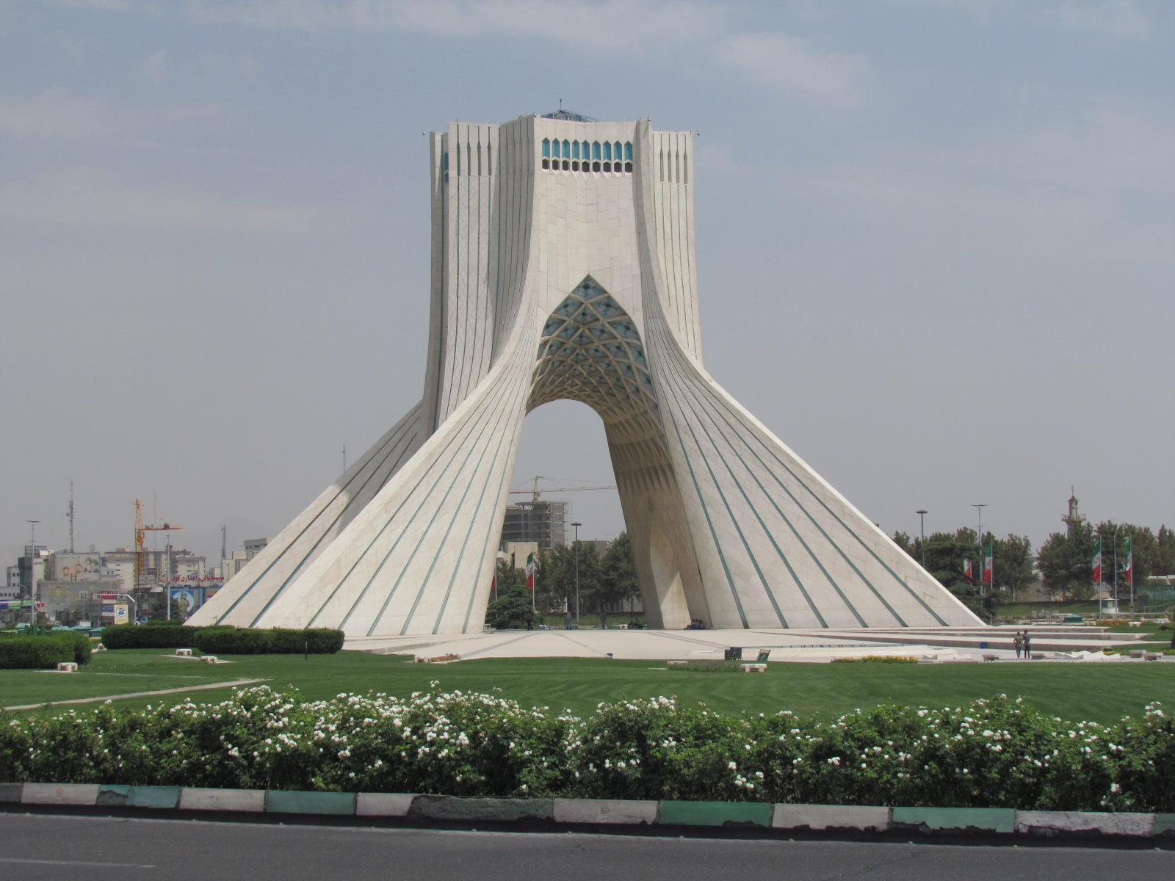
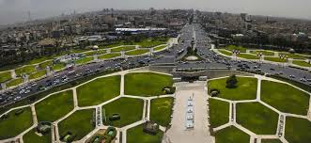

Slide 4
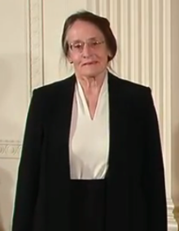

Mary Shaw and David Garlan. Software Architecture: Perspectives on an Emerging Discipline, Prentice Hall, 1996.
Mary Shaw. "Comparing Architectural Design Styles". in: IEEE Software, 12(6):27–41, 1995.

Slide 5
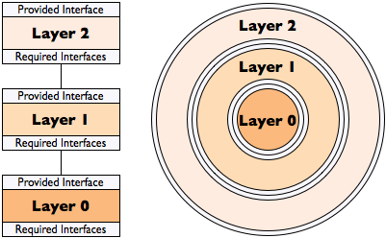

Slide 6
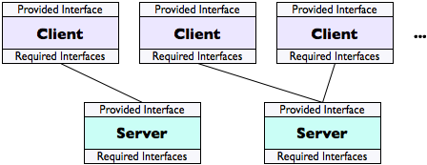

Slide 7


Slide 8
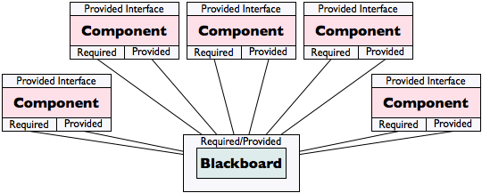

Slide 9
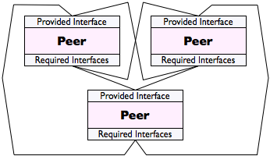

Slide 10
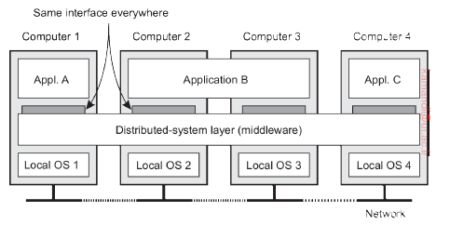
[Tanenbaum, 2017]

Slide 11
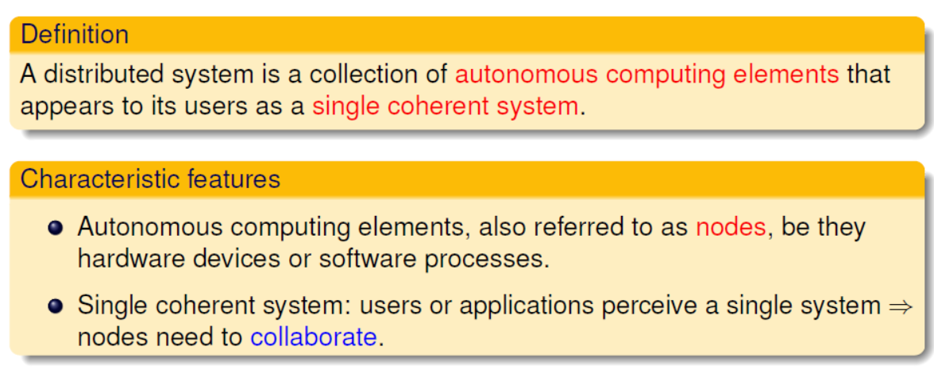
Distributed System: Definition (Tanenbaum)

Slide 12
Definition of Distributed System
Distributed systems are characterized by their structure: a typical distributed system will consist of some large number of interacting devices that each run their own programs but that are affected by receiving messages, or observing shared-memory updates or the states of other devices. Examples of distributed computing systems range from simple systems in which a single client talks to a single server to huge amorphous networks like the Internet as a whole.
[Aspnes, 2017]

Slide 13
Definition of Distributed System
Leslie Lamport once said: A distributed system is one in which the failure of a computer you didn’t even know existed can render your own computer unusable.
[Ghosh, 2007]

Slide 14


Definition of Distributed System
A distributed system is a collection of independent entities that cooperate to solve a problem that cannot be individually solved. Distributed systems have been in existence since the start of the universe. [Singhal, 2008]

Slide 15
Distributed systems are a computing paradigm whereby two or more nodes work
with each other in a coordinated fashion in order to achieve a common outcome and
it's modeled in such a way that end users see it as a single logical platform.
[Bashir]

Slide 16

Bitcoin
Bitcoin is a cryptocurrency and worldwide payment system.
Decentralized digital currency
Without central bank or single administrator
The network is peer-to-peer and transactions take place between users directly, without an intermediary.
These transactions are verified by network nodes through the use of cryptography and recorded in a public distributed ledger called a blockchain.
Bitcoin was invented by an unknown person or group of people under the name Satoshi Nakamoto and released as open-source software in 2009.

Slide 17
Bitcoin
Nakamoto, Satoshi (31 October 2008). "Bitcoin: A Peer-to-Peer Electronic Cash System" (PDF). bitcoin.org.
Bitcoins are created as a reward for a process known as mining.
They can be exchanged for other currencies, products, and services.
As of February 2015, over 100,000 merchants and vendors accepted bitcoin as payment.
Research produced by the University of Cambridge estimates that in 2017, there are 2.9 to 5.8 million unique users using a cryptocurrency wallet, most of them using bitcoin

Slide 18
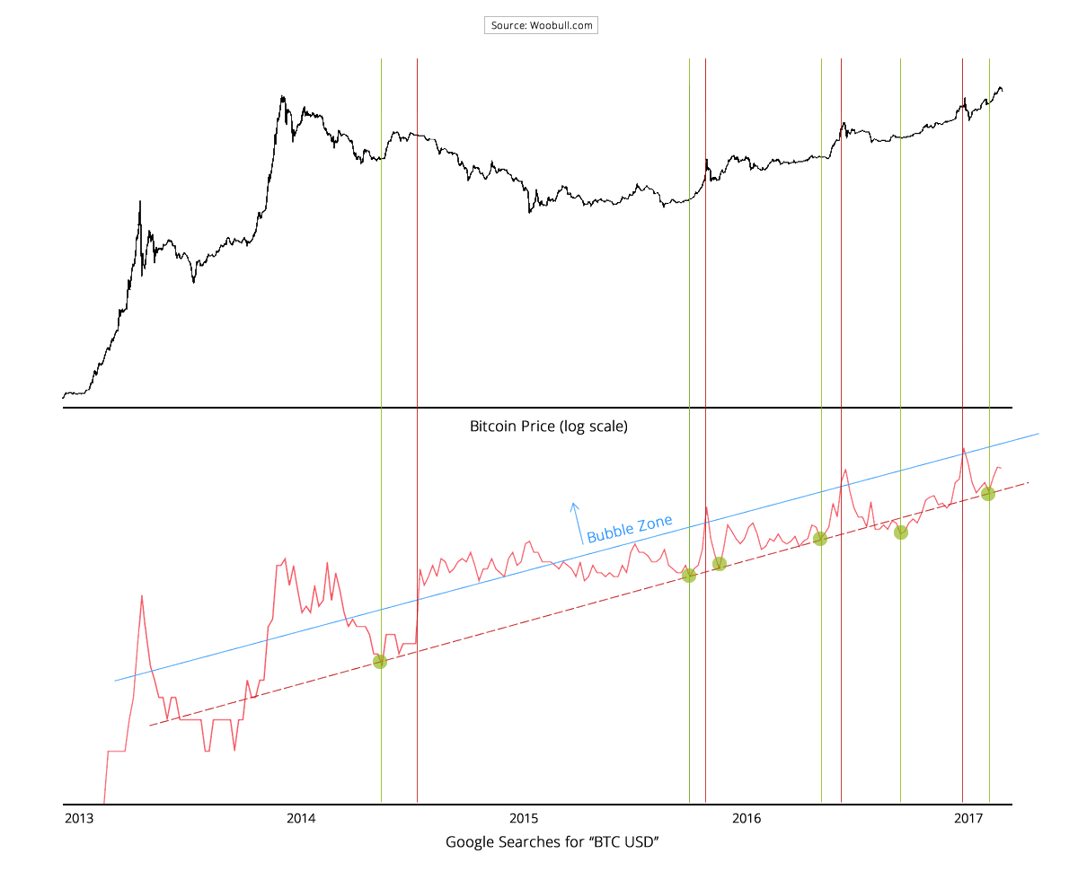

Slide 19
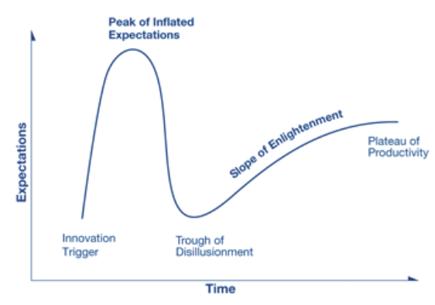
Gartner Hype Cycle
Notes:
مرحله 1: محرک فناوری: معرفی غیرمنتظره فناوری جدید-هیچ محصولی هوز عرضه نشده-توجه رسانه ها
مرحله 2- اوج حباب انتظارات: تبلیغات زیاد- انتظارات رویایی از تکنولوژی جدید
مرحله 3- ترکیدن حباب-مواجهه با شکستهای اولیه-بهبود جهت دوام
مرحله 4- شیب روشنگری: نمونه هایی از اینکه فناوری چگونه به سازمان سود می رساند. محصولات نسل دوم و سوم ارائه می شوند. سرمایه گذاری های بیشتر ولی واقع گرایانه-
مرحله 5: دشت بهره وری: پذیرش عمومی-کاربرد بازاری گسترده
راهنمای سرمایه گذاری- تصمیمات استراتژیک

Slide 20
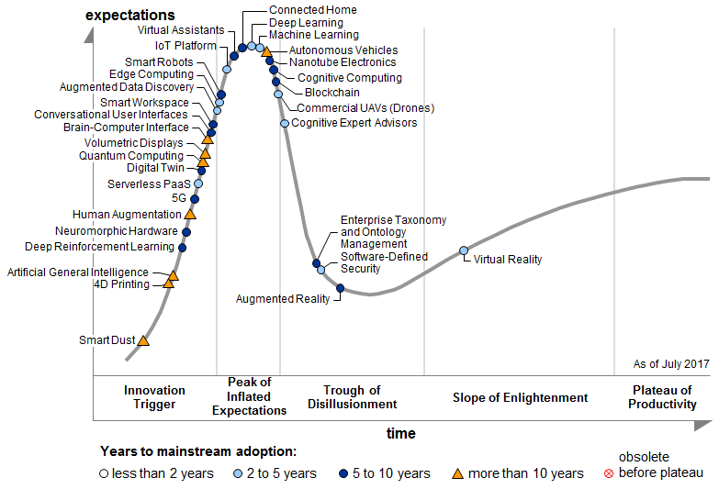
Notes:
گارتنر 2017

Slide 21
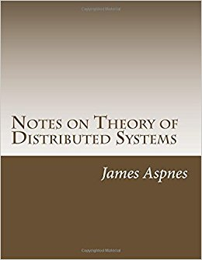
James Aspnes, Notes on Theory of Distributed Systems, 2017.

Slide 22
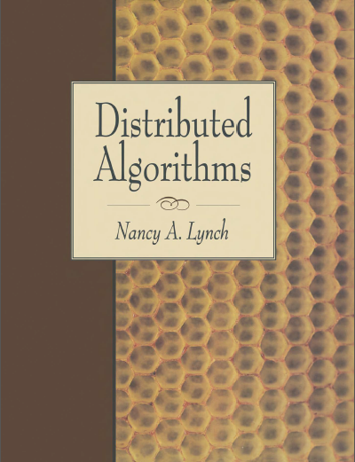
Nancy A. Lynch, Distributed Systems, 1996.

Slide 23
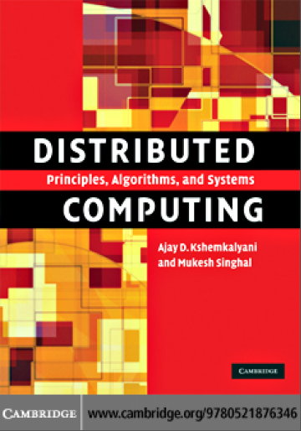
Ajay D. Kshemkalyani and Mukesh Singhal, Distributed Computing, 2008.

Slide 24
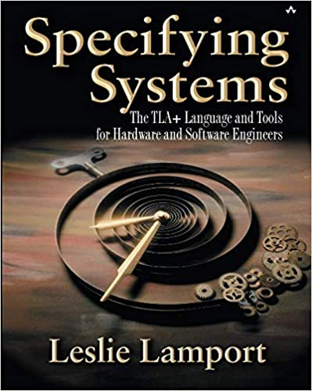

Slide 25
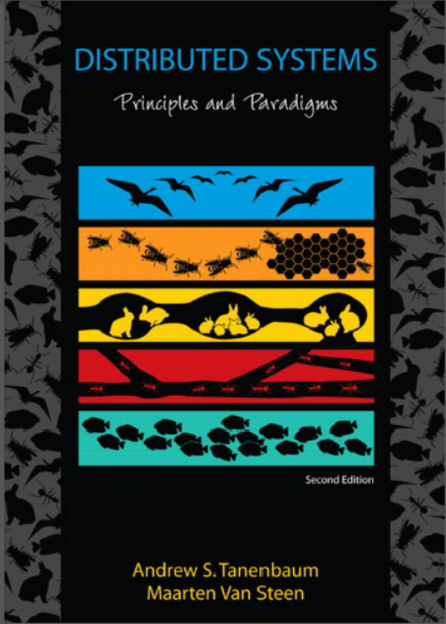
Andrew S. Tanenbaum, Maarten Van Steen,
Distributed systems, principles and paradigms,
3rd edition, 2017.

Slide 26
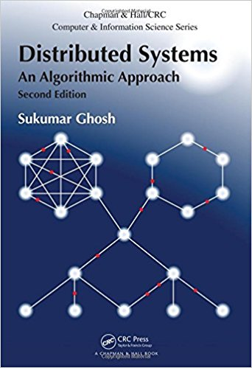
Sukumar Ghosh, Distributed Systems, an algorithmic approach, second edition, 2015.

Slide 27
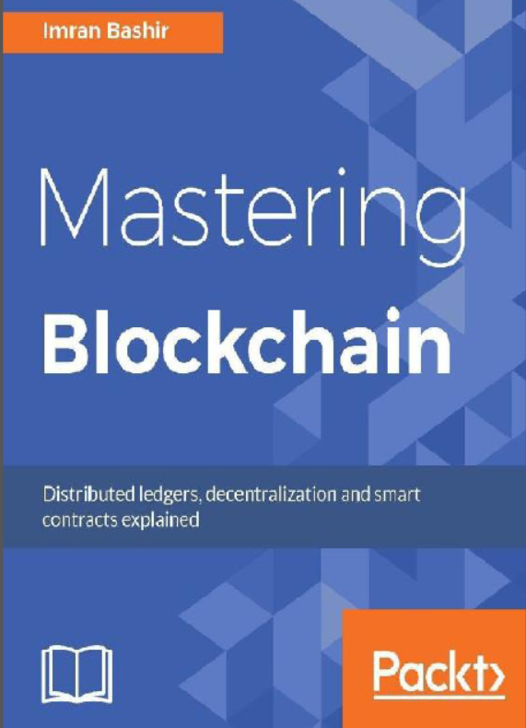

Slide 28
Group Homework 1
Research about Blockchain and write a report (2 pages)
Study about the CAP theorem and write a one page report.
Nakamoto, Satoshi (31 October 2008). "Bitcoin: A Peer-to-Peer Electronic Cash System" (PDF). bitcoin.org.
Each group: 3 students

Slide 29
Distributed System Types
Fully
Distributed
Control
Data
Autonomous
fully cooperative
Local data,
local directory
Autonomous
transaction based
Not fully replicated
master directory
Master-slave
Fully replicated
Homog.
special
purpose
Homog.
general
purpose
Processors
Heterog.
special
purpose
Heterog.
general
purpose
Notes:
Systems involve hardware (processors), application and system software (control) and application and system information (data).
Which of these dimensions have to be distributed for the system to be a distributed system?
Enslow requires that distribution is transparent and system users are unaware of the fact that the system is composed of multiple processors.
Enslow´s model (1978) is fairly rigid: A system is a fully distributed system if and only if all dimensions are fully decentralized.
Full hardware decentralization includes multiple heterogeneous control units (as opposed to a single control unit with multiple processors and multiple homogeneous control units).
Control must be provided by multiple units cooperating with each other rather than in a master-slave relationship
Data must be partitioned and/or replicated, each part with its own local directory.
Enslow´s definition is too restrictive in our opinion. Techniques of distributed system construction should also be employed if only a single dimension is decentralized.

Slide 30
CAP Theorem
This is also known as Brewer's theorem, introduced originally by Eric Brewer as a conjecture in 1998; in 2002 it was proved as a theorem by Seth Gilbert and Nancy Lynch.
Any distributed system cannot have Consistency, Availability, and Partition tolerance simultaneously:
Consistency is a property that ensures that all nodes in a distributed system have a single latest copy of data
Availability means that the system is up, accessible for use, and is accepting incoming requests and responding with data without any failures as and when required
Partition tolerance ensures that if a group of nodes fails the distributed system still continues to operate correctly

Slide 31
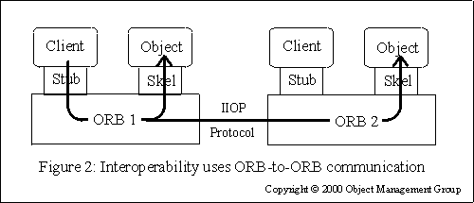
CORBA

Slide 32
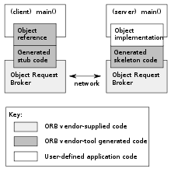
Notes:
CORBA uses an interface definition language (IDL) to specify the interfaces that objects present to the outer world. CORBA then specifies a mapping from IDL to a specific implementation language like C++ or Java. Standard mappings exist for Ada, C, C++, C++11, COBOL, Java, Lisp, PL/I, Object Pascal, Python, Ruby and Smalltalk. Non-standard mappings exist for C#, Erlang, Perl, Tcl and Visual Basic implemented by object request brokers (ORBs) written for those languages.

Slide 33
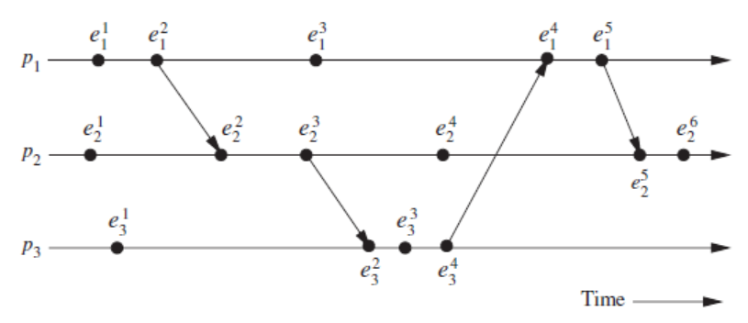
Model of Distributed Execution

Slide 34
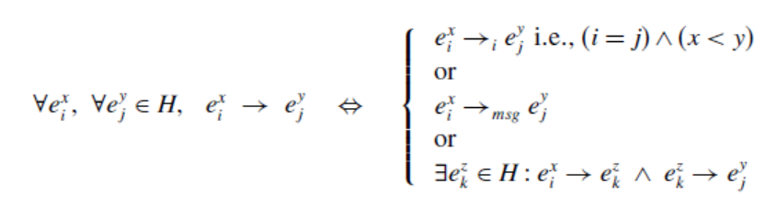
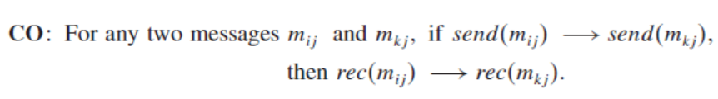
Causal precedence relation

Slide 35
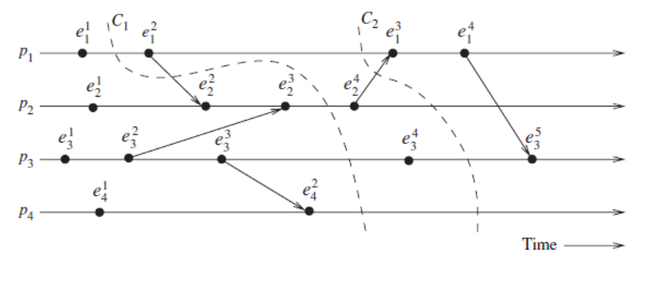

Slide 36
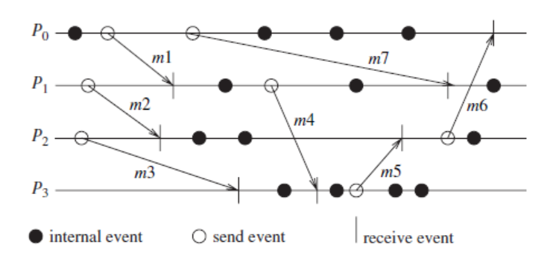
Asynchronous Execution

Slide 37
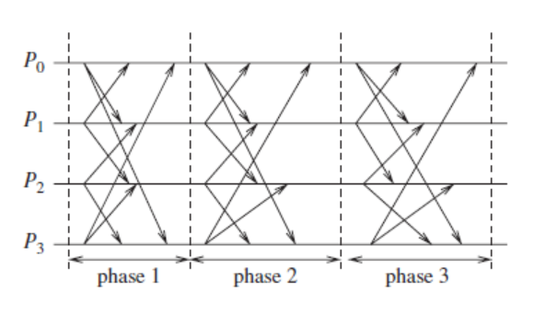
Synchronous Execution

Slide 38
